Slide 1
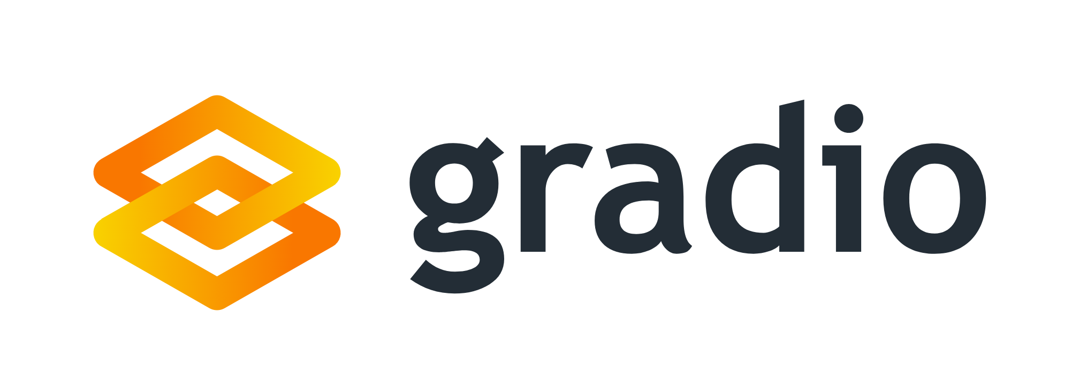
Prithvi Raj Allada and Abdur Rahman

Slide 2
What is gradio and why would a Data Scientist use it?

Slide 3
Life of a Data Scientist
The chief responsibility of a data scientist is to develop solutions using machine learning models for various business problems.
90% of the time cleaning and understanding data
10% of the time demoing machine learning models
During the lifecycle of a machine learning project, data scientists have to overcome different challenges related to the nature of the problem, and many times most of the models developed never see the light of the day.
Additionally, data scientists often lack web development skills, making it hard to prepare models for production use. This gap hinders stakeholders and managers from understanding the project's progress, as it can take weeks or months to present a model in a user-friendly application form.
Gradio can add value to users by making the intermediate outputs of points 1 and 2 easier to share
Notes:
Gradio can help to quickly create simple interfaces to display models and progress to clients.

Slide 4
Introduction
Gradio is a Python library that's free and open-source, designed for the swift creation of demos or web applications for machine learning models, APIs, or any Python function. It features easy sharing capabilities, enabling you to distribute a link to your demo or web app in mere seconds through Gradio's sharing options, all without requiring knowledge of JavaScript, CSS, or web hosting.

Slide 5
What can gradio create?

Slide 6
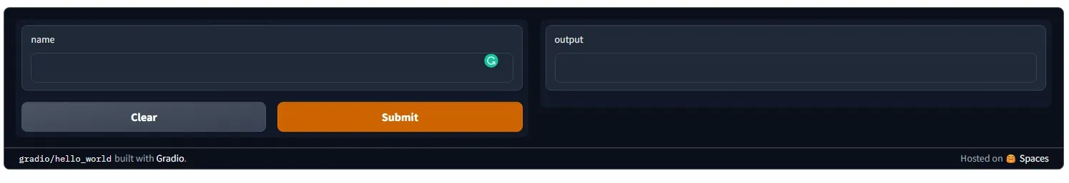
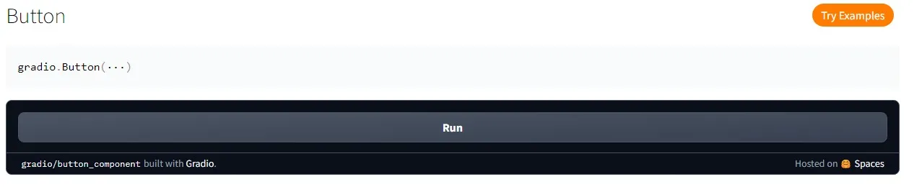
Interfaces(web-based GUI)
Components (ready-to-use components)

Slide 7
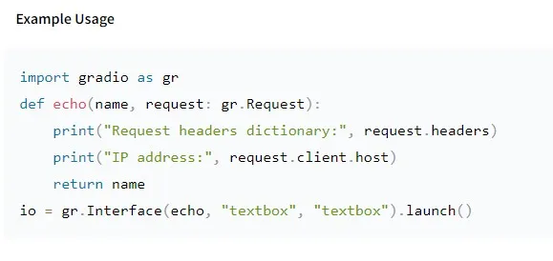
Routes (interact with API’s)

Slide 8
Setup
Gradio installation is fast and easy to setup .You can install Gradio using pip command.
Once Installed, import gradio to you python notebook.

Slide 9
Types of Demos
Interface
ChatInterface
TabbedInterface
Blocks

Slide 10
Types of Methods
Launch
Load
from_pipeline
Integrate
queue

Slide 11
load method
This listener is triggered when the Interface initially loads in the browser.
Notes:
Method Load - close to 20 arguments.

Slide 12
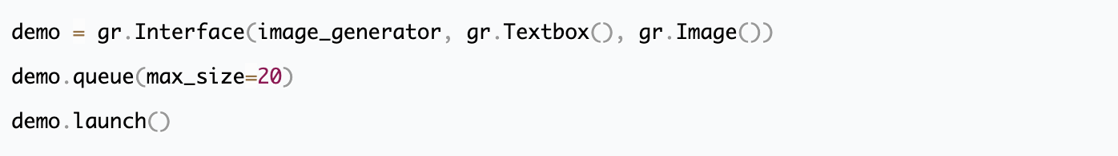
from_pipeline: Class method that constructs an Interface from a Hugging Face transformers.Pipeline or diffusers.DiffusionPipeline object. The input and output components are automatically determined from the pipeline.
Integrate: A catch-all method for integrating with other libraries. This method should be run after launch()
queue: By enabling the queue you can control when users know their position in the queue, and set a limit on maximum number of events allowed.
Notes:
from_pipleline requires tensorflow and pytorch
queue: max_size=20

Slide 13
Interface
Designed to create demos for machine learning models which accepts one or more inputs and returns one or more outputs
fn: the function to wrap a user interface (UI) around
inputs: the Gradio component(s) to use for the input. The number of components should match the number of arguments in your function.
outputs: the Gradio component(s) to use for the output. The number of components should match the number of return values from your function.
The input and output arguments take one or more Gradio components. It includes more than 30 built-in components (such as the gr.Textbox(), gr.Image(), and gr.HTML() components) that are designed for machine learning applications.
Notes:
Interface is Gradio's main high-level class, and allows you to create a web-based GUI / demo around a machine learning model (or any Python function) in a few lines of code. You must specify three parameters: (1) the function to create a GUI for (2) the desired input components and (3) the desired output components. Additional parameters can be used to control the appearance and behavior of the demo.

Slide 14
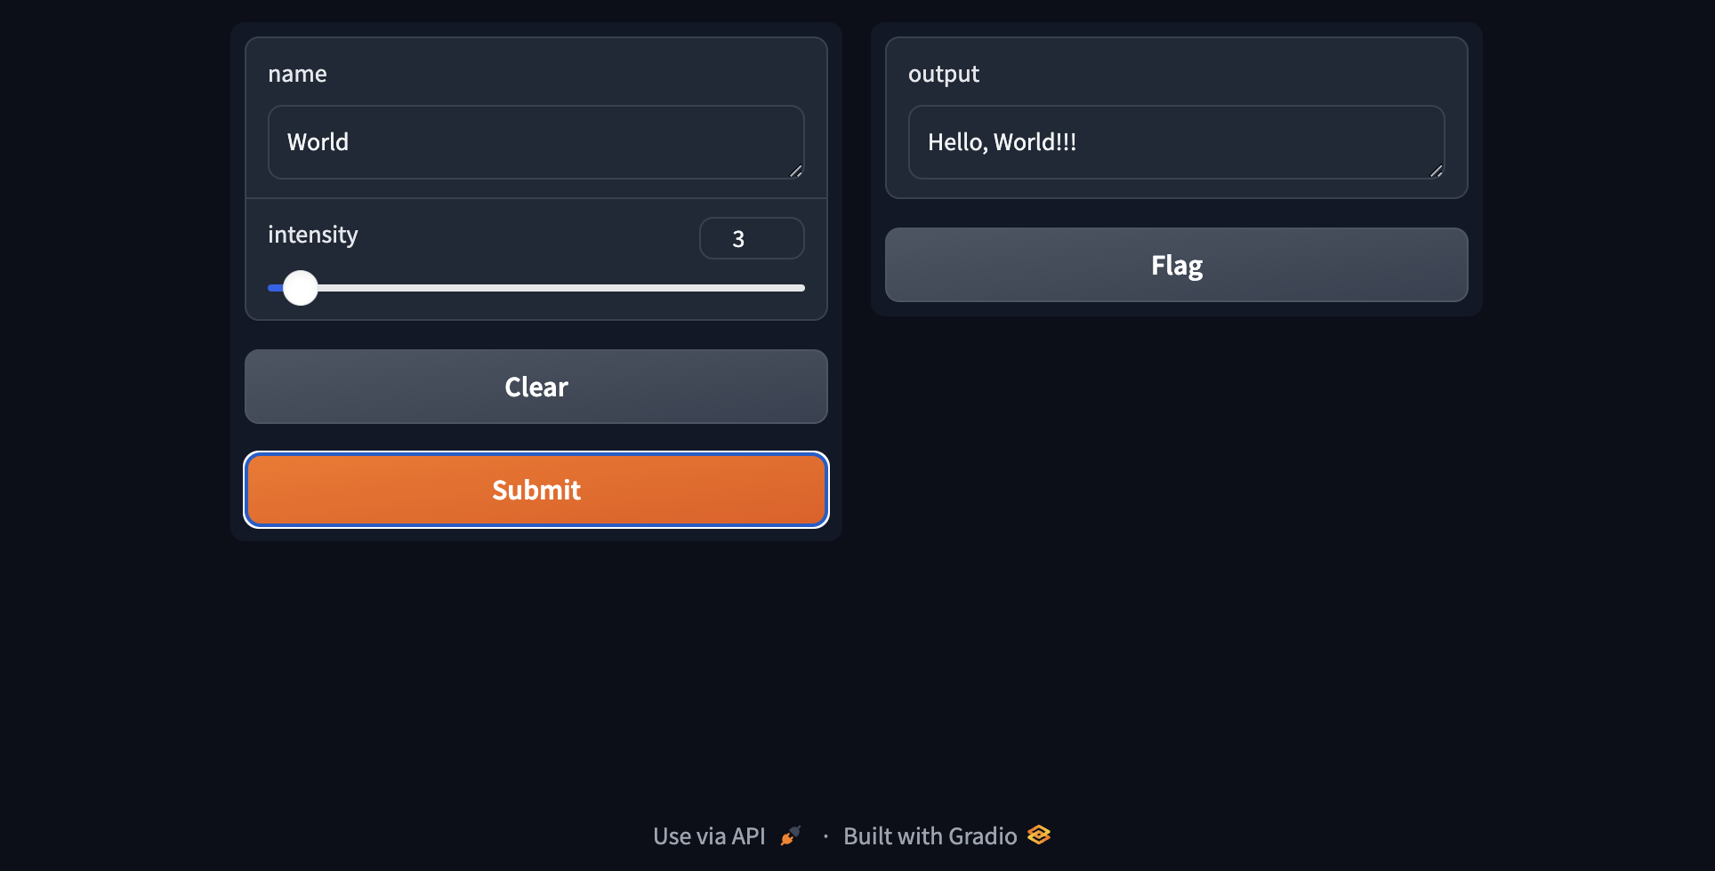
First Demo!

Slide 15
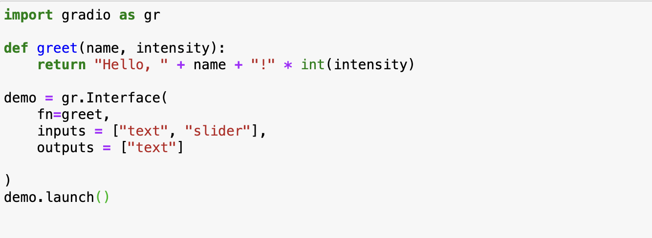
First Demo!

Slide 16
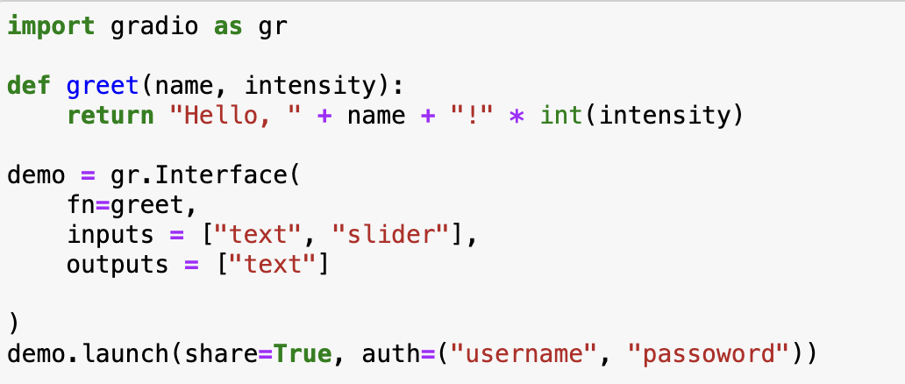
Sharing your Demo - launch method
Notes:
Method Launch - close to 30 parameters

Slide 17
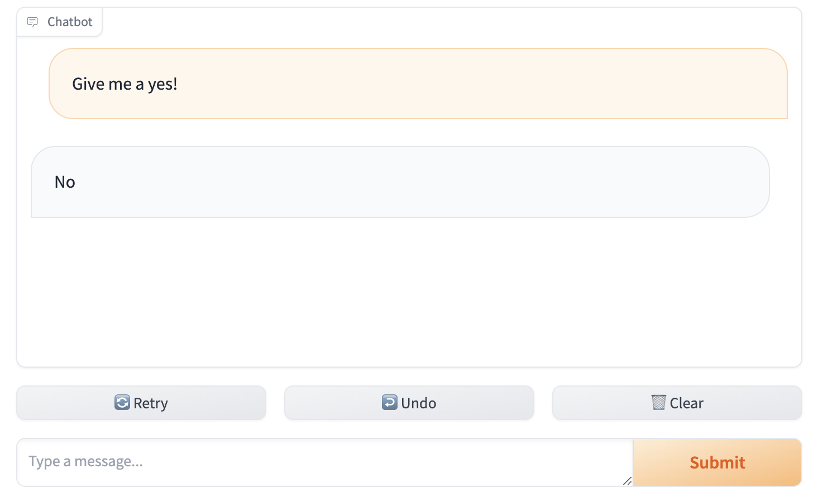
ChatInterface
ChatInterface is Gradio's high-level abstraction for creating chatbot UIs, and allows you to create a web-based demo around a chatbot model in a few lines of code. Only one parameter is required: fn, which takes a function that governs the response of the chatbot based on the user input and chat history. Additional parameters can be used to control the appearance and behavior of the demo.
Notes:
Interface is Gradio's main high-level class, and allows you to create a web-based GUI / demo around a machine learning model (or any Python function) in a few lines of code. You must specify three parameters: (1) the function to create a GUI for (2) the desired input components and (3) the desired output components. Additional parameters can be used to control the appearance and behavior of the demo.

Slide 18
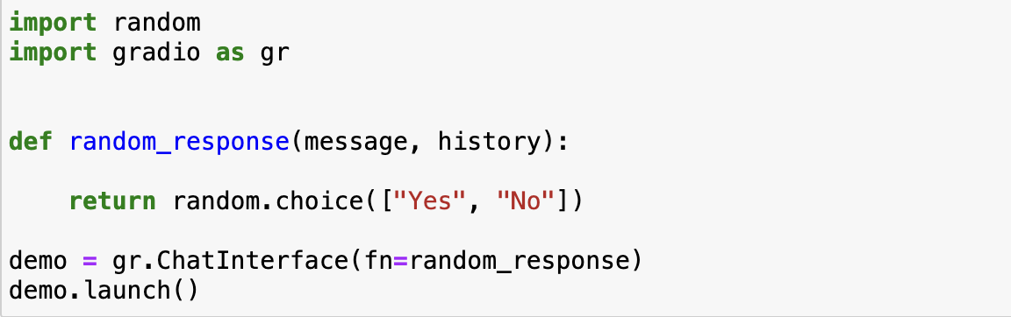
ChatInterface - Demo
Notes:
Interface is Gradio's main high-level class, and allows you to create a web-based GUI / demo around a machine learning model (or any Python function) in a few lines of code. You must specify three parameters: (1) the function to create a GUI for (2) the desired input components and (3) the desired output components. Additional parameters can be used to control the appearance and behavior of the demo.

Slide 19
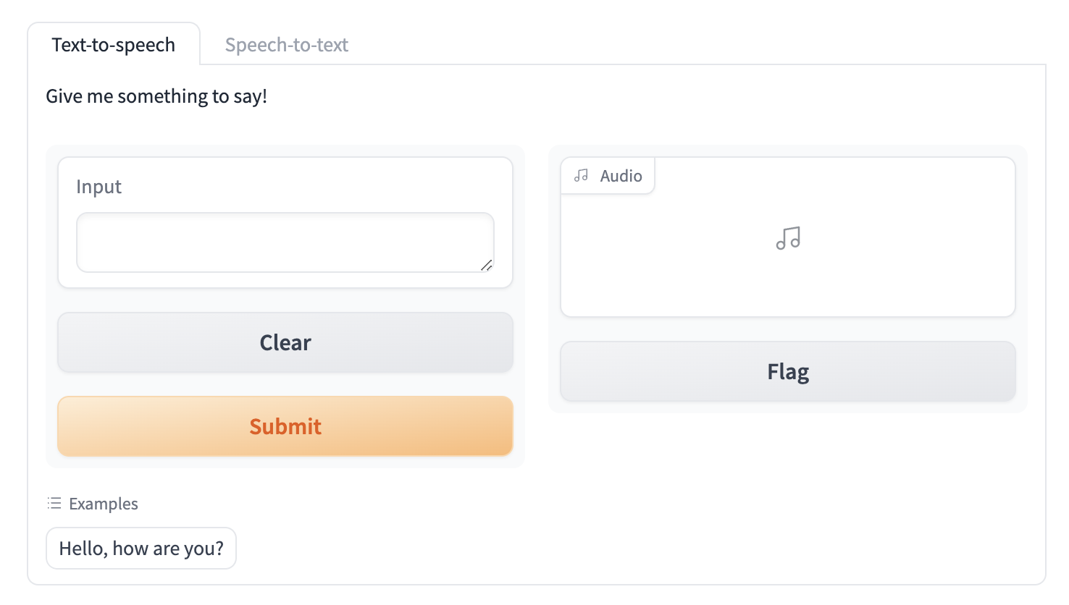
TabbedInterface
A TabbedInterface is created by providing a list of Interfaces or Blocks, each of which gets rendered in a separate tab. Only the components from the Interface/Blocks will be rendered in the tab. Certain high-level attributes of the Blocks (e.g. custom css, js, and head attributes) will not be loaded.

Slide 20
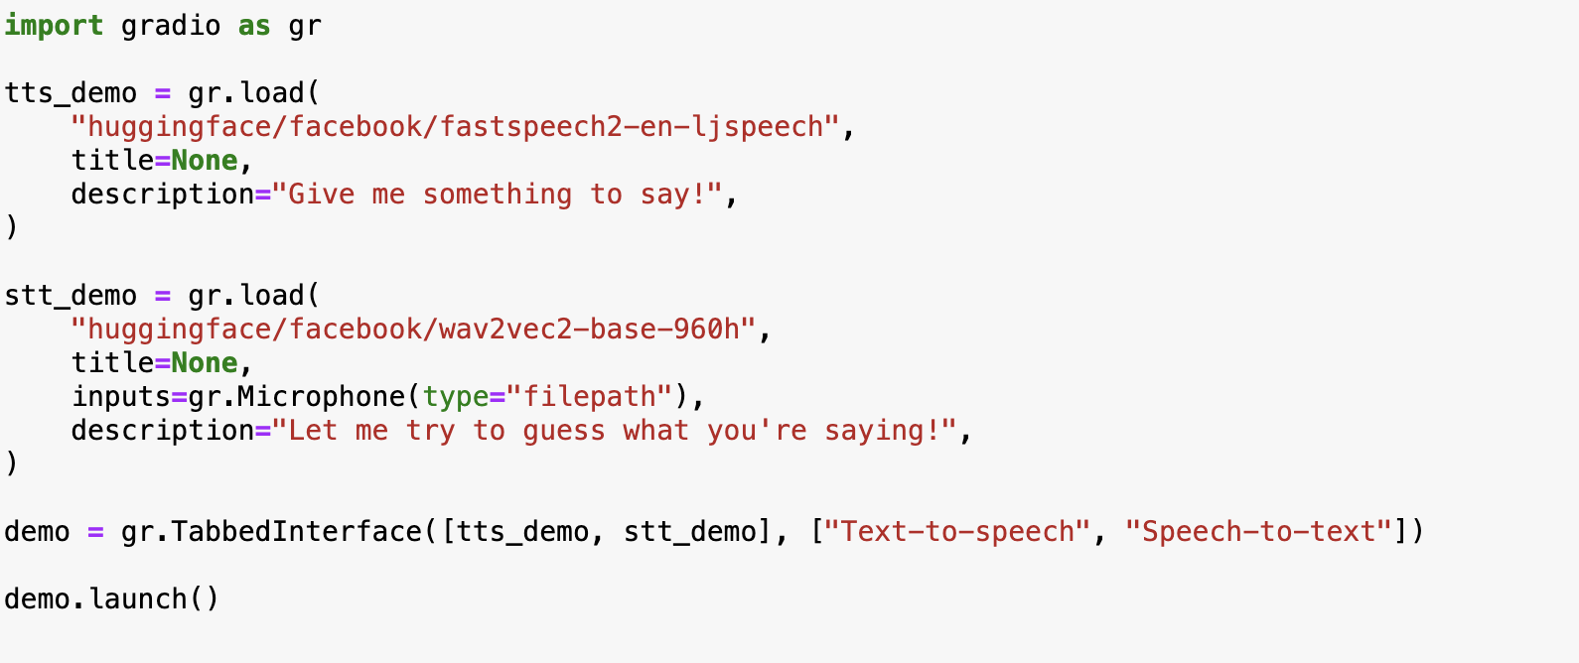
TabbedInterface - Demo

Slide 21
Blocks
Blocks is Gradio's low-level API that allows you to create more custom web applications and demos than Interfaces (yet still entirely in Python).
Compared to the Interface class, Blocks offers more flexibility and control over: (1) the layout of components (2) the events that trigger the execution of functions (3) data flows (e.g. inputs can trigger outputs, which can trigger the next level of outputs). Blocks also offers ways to group together related demos such as with tabs.

Slide 22
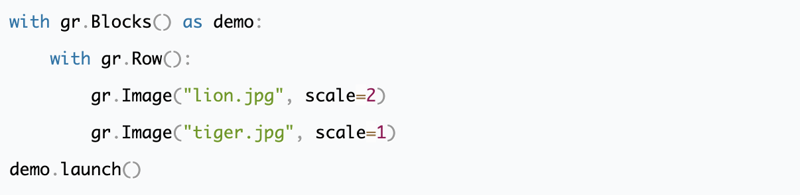
Blocks
Row: Row is a layout element within Blocks that renders all children horizontally

Slide 23
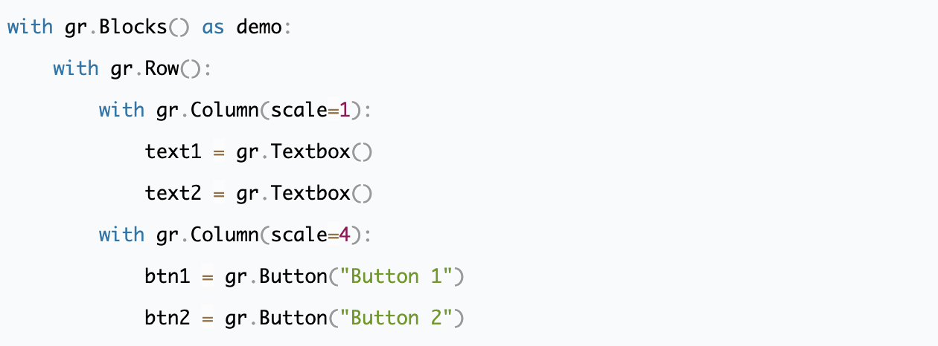
Blocks
Column: Column is a layout element within Blocks that renders all children vertically. The widths of columns can be set through the scale and min_width parameters.

Slide 24
Blocks
Tab: Tab (or its alias TabItem) is a layout element. Components defined within the Tab will be visible when this tab is selected tab
Group: Group is a layout element within Blocks which groups together children so that they do not have any padding or margin between them
Accordion: Accordion is a layout element which can be toggled to show/hide the contained content

Slide 25
Creating a Real-Time Dashboard from Google Sheets
Google Sheets are an easy way to store tabular data in the form of spreadsheets. With Gradio and pandas, it’s easy to read data from public or private Google Sheets and then display the data or plot it. here, we’ll build a small real-time dashboard, one that updates when the data in the Google Sheets updates.
Random public google sheet for line chart: https://docs.google.com/spreadsheets/d/1UoKzzRzOCt-FXLLqDKLbryEKEgllGAQUEJ5qtmmQwpU/edit#gid=0

Slide 26
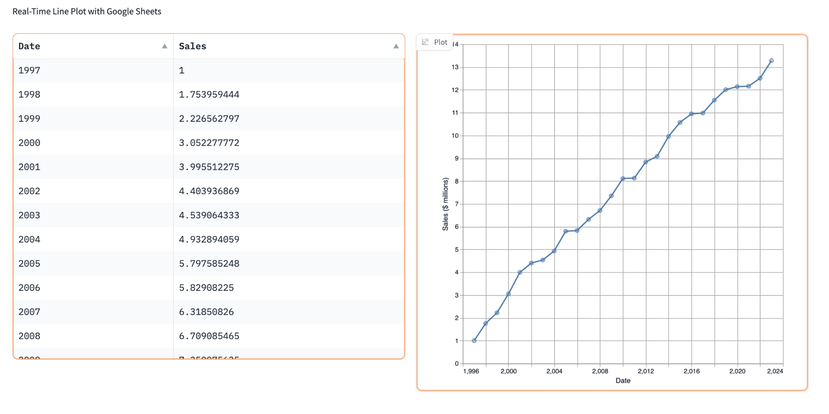
Creating a Real-Time Dashboard from Google Sheets - Demo

Slide 27
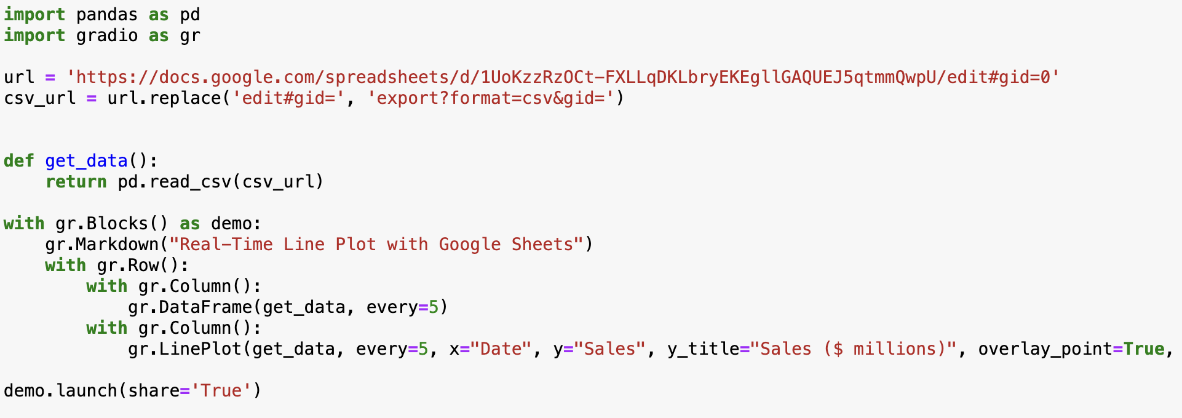
Creating a Real-Time Dashboard from Google Sheets - Demo

Slide 28
Gradio Flexibility
Cloud based database services like Google BigQuery and Supabase
Connect to any database - as long as you can write python code to connect to your data
Plot Components for Maps
Style the Gradio DataFrame
Tabular Workflows

Slide 29
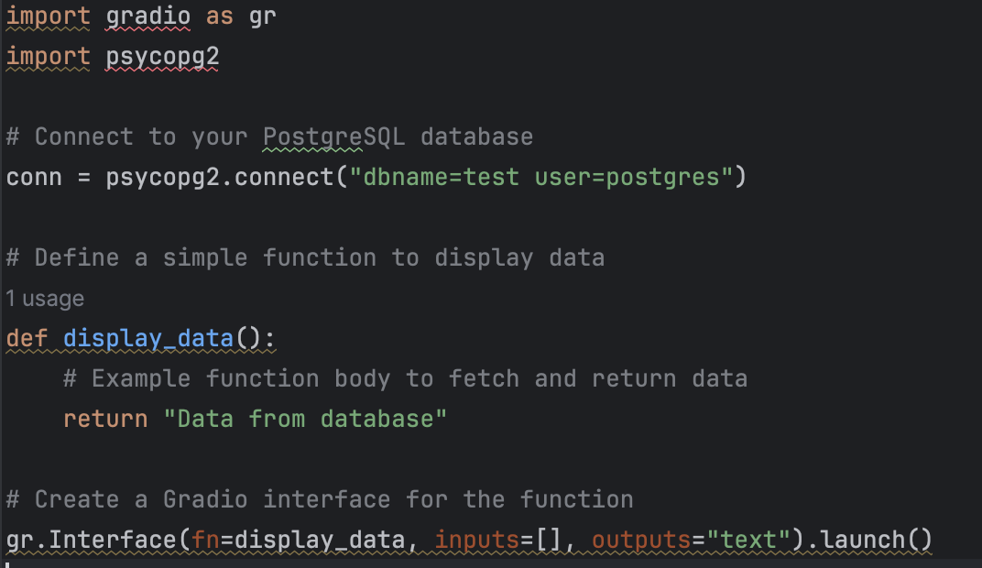
Connecting to a Database
Gradio can be connected to any type of database.
Example Code to connect it to a postgres database.
Notes:
Method Launch - close to 30 methods

Slide 30
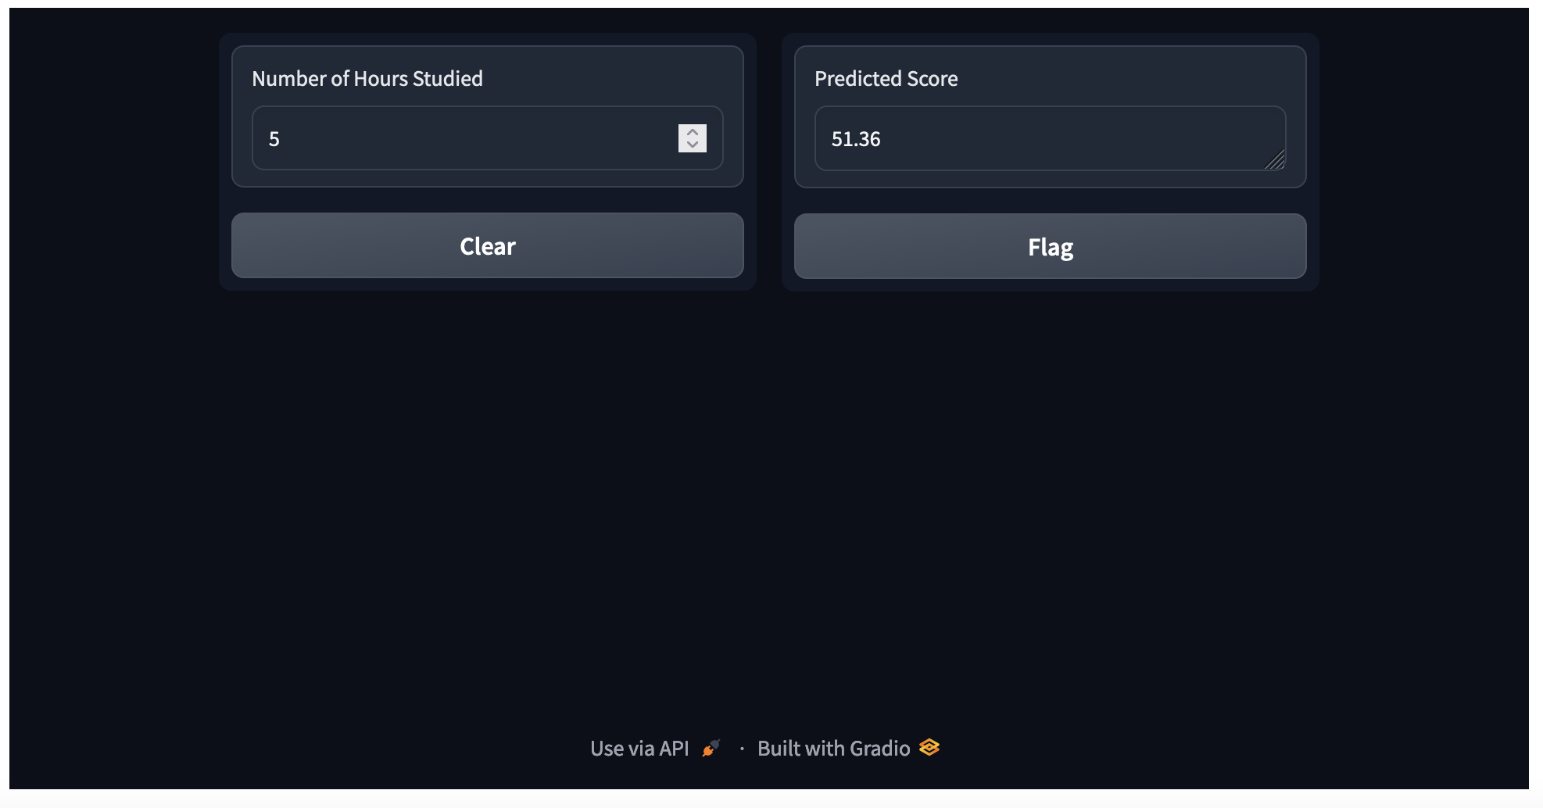
Creating a GUI for Linear Regression Model
Predicting the Score of an student based on the number of hours they study

Slide 31
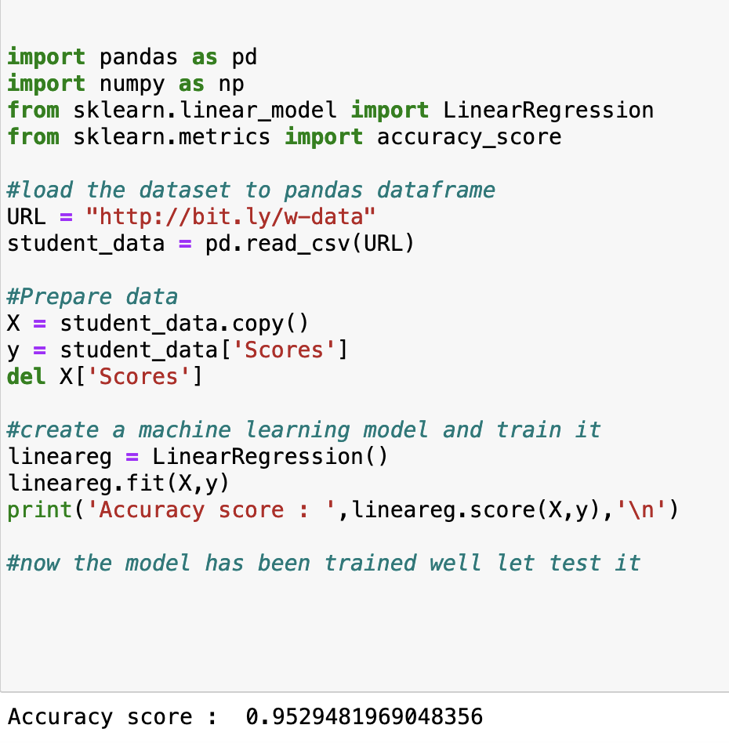
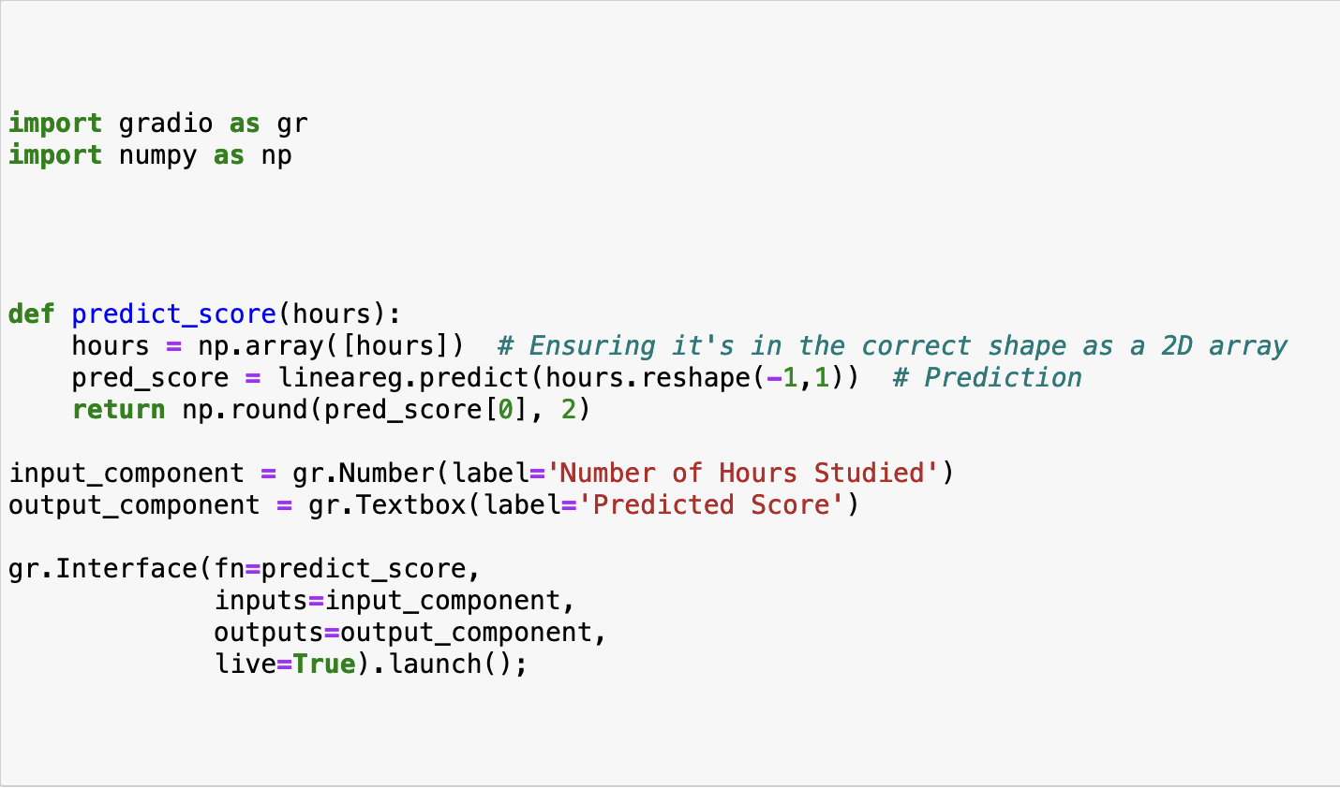
Creating a GUI for Linear Regression Model
Linear Regression Model

Slide 32
THANKS!
Do you have any questions?

